Slide 1
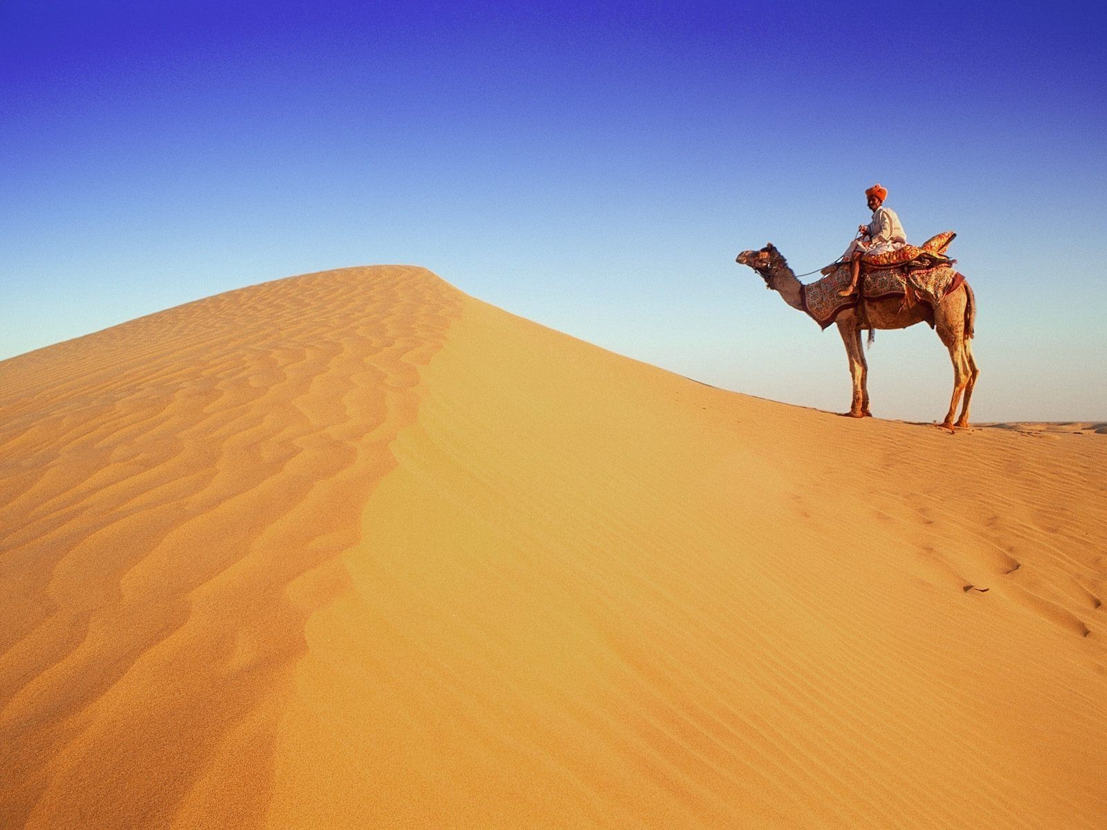
Report and Check-
A Portal for Travellers
At Royal Land

Slide 2
Report and check is a web portal for travellers to report their
problems and issues ,and at the same time time get an idea of
area they are visiting to ensure a comfortable and safe
journey

Slide 3
Components
Reporting Problem
Getting Alerts

Slide 4
Reporting problems
In our project, tourists can give their reviews on various
problems such as robbery, sexual harassment and cheating ,
etc. around any tourists place.
The problems thus can be brought into the direct notice of
government officials and they can take the required steps .

Slide 5
Getting Alerts
When a tourist decides to visit a place, he can sign up on portal for getting alerts and reports regarding issues and problems mostly faced there.
This will not only help tourists in being more precautious, but will also
help government providing required safety measures.

Slide 6
Languages, frameworks and
APIs used
Bootstrap
Jquery
Javascript
Json
Html
Css
Google APIs
Google firebase

Slide 7
Thanking you
Akshay Sharma
Aakansha Jain
Arpit Jain
Ayush Johri
Team name-Rookies

